Slide 1


Building Data Lake on GCP
School of Creative Technologies, The University of Bolton,UK
07-April-2022
Ankit Mishra & Anmol Kankariya

Slide 2


About us
I am a Big Data Engineer/Solution Architect with 10 years+ of extensive hands on technical expertise in designing and developing complex data processing frameworks.
Currently working as a Senior Data Engineer/Architect with Zenjob Gmbh, Berlin Germany.
Professional Data Engineer - Google Cloud
Previously worked with DXC Technology,Sopra-Steria, Western Union and Micron Technology
I am a Cloud Data Engineer with 2.5 years of experience in building Data Intensive Applications.
Currently working as a Cloud Data Engineer with Google Inc. India.
Professional Data Engineer - Google Cloud
Previously worked with Micron Technology.

Slide 3
Agenda
What is Data Lake ?
Data Lake Use Case
Data Lake Architecture
GCP Setup
GCP Big Data Products
Big Query
Cloud SQL to BigQuery Use Case
Machine Learning Introduction
BigQuery ML Use Case
GCS to BigQuery Use Case

Slide 4
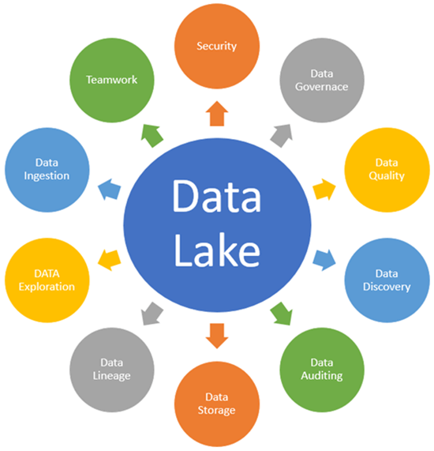
What is Data Lake ?
A data lake is a centralized and secure data platform
to ingest,store,process and analyze all structured,
semi-structured and unstructured data at any scale.
Reason of storing data is undefined.
Data is left raw until it is needed.

Slide 5
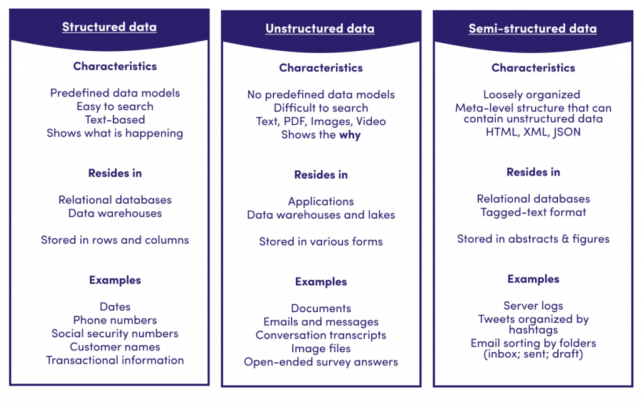
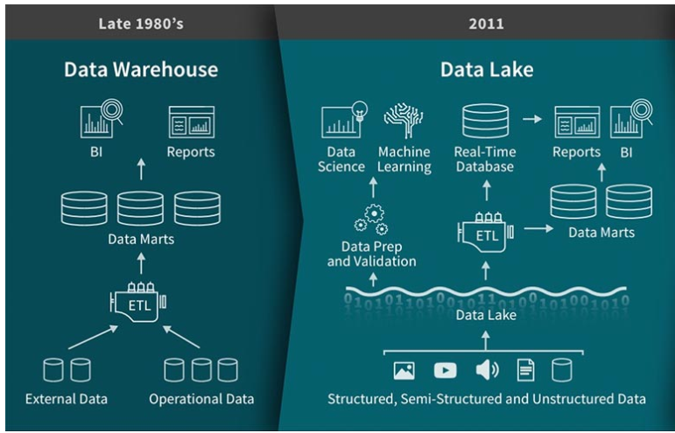
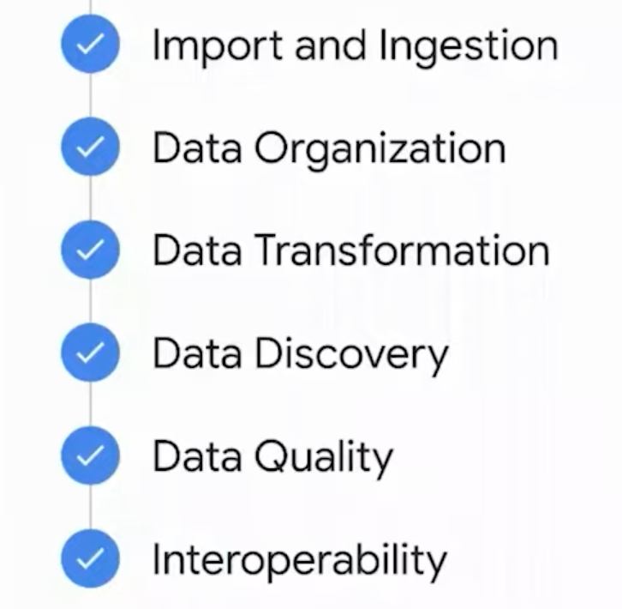

Slide 6
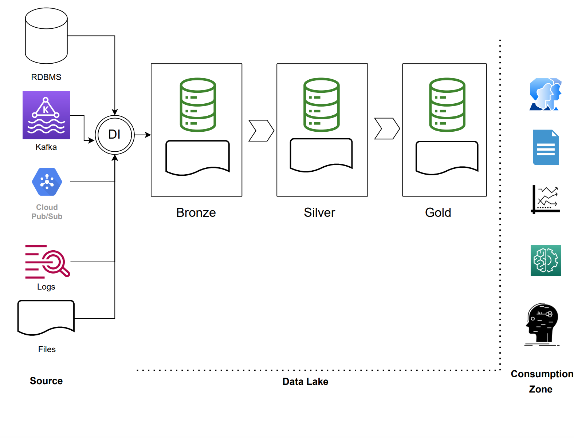
Data Lake Architecture

Slide 7
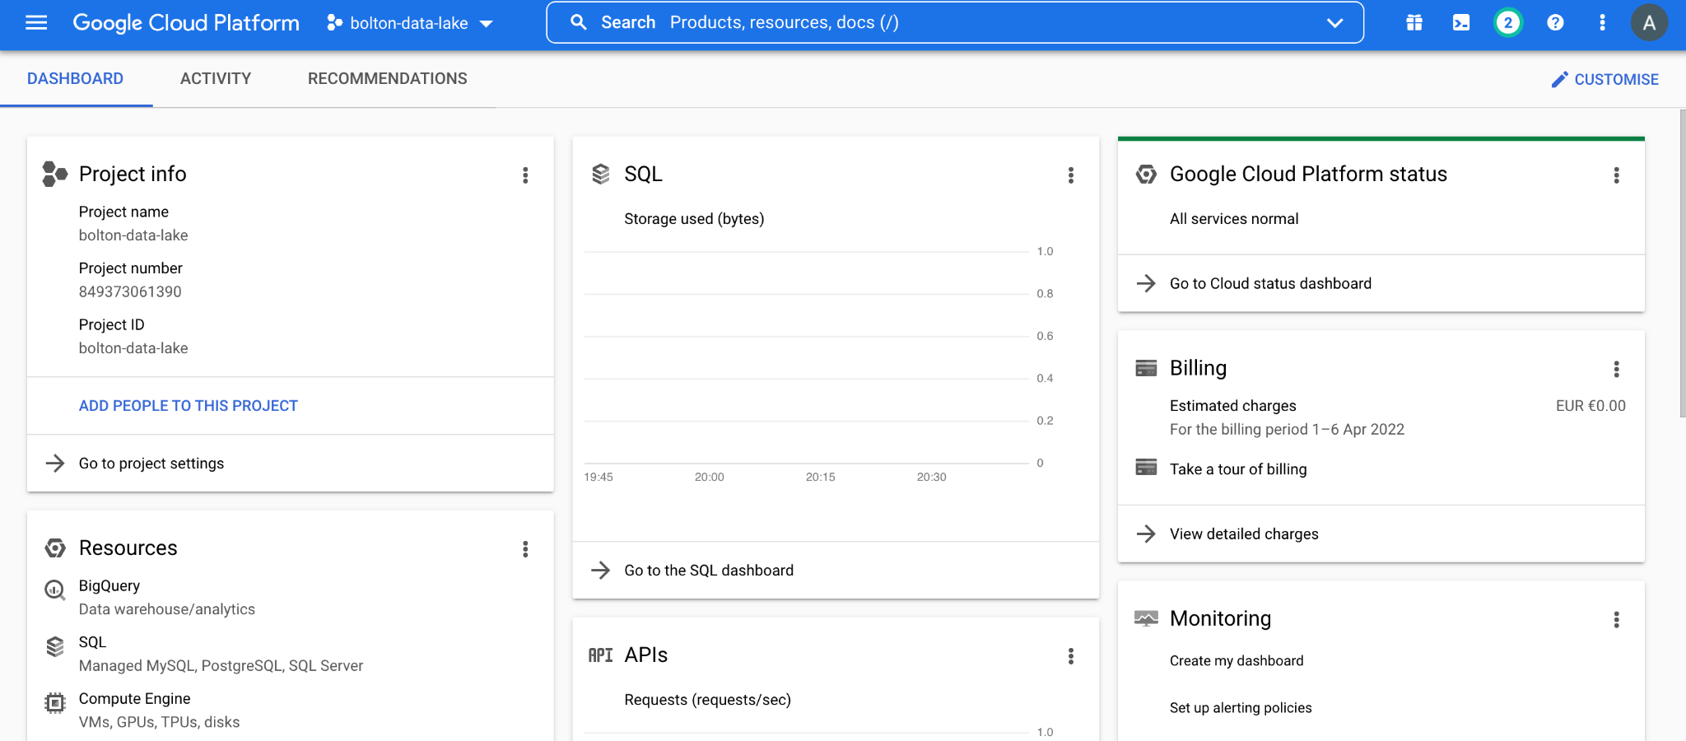
GCP Setup
Login to Google Cloud
Get $300 in free credits and free usage of 20+ products
Set Up billing alert
Install Google Cloud SDK on your machine
IAM and Enable APIs and Services.

Slide 8
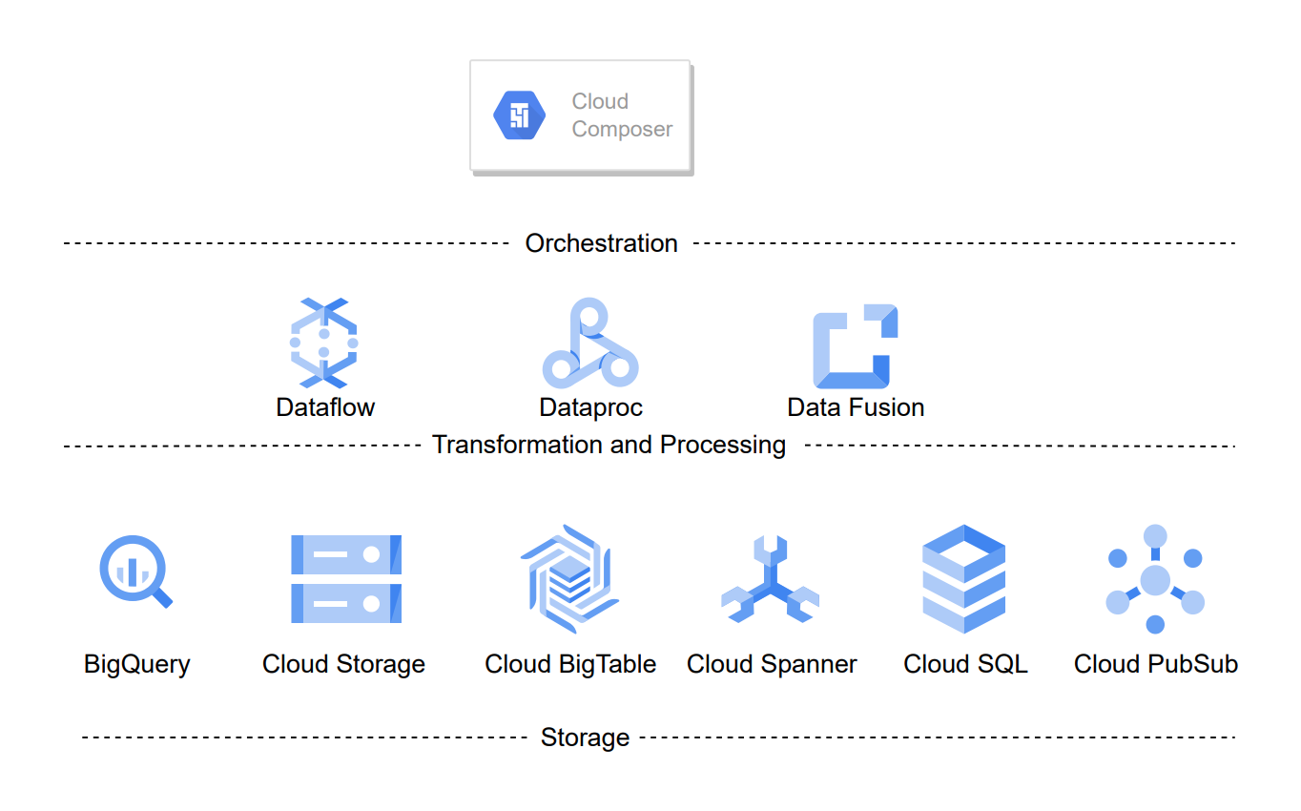
GCP Big Data Products

Slide 9
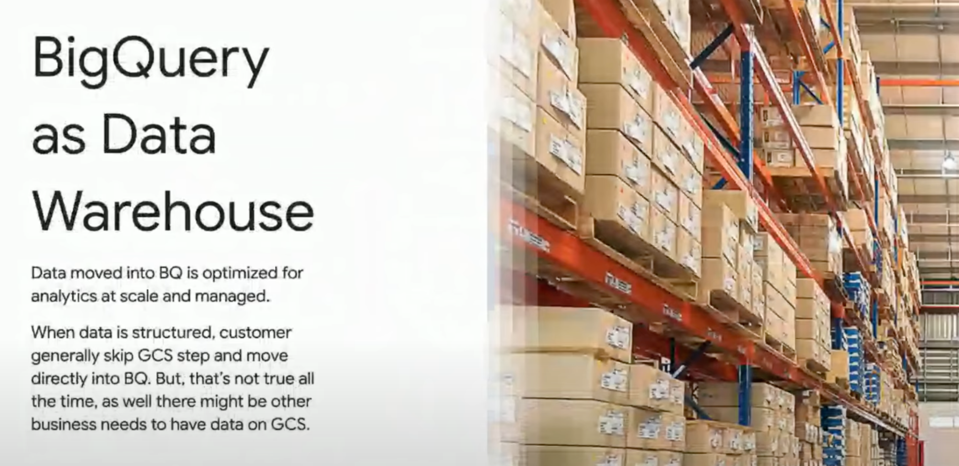
What is BigQuery?
Fully managed
Petabytes scale
Industry-standard SQL
Embedded ML
Automatically encrypted
Durable
Highly available

Slide 10
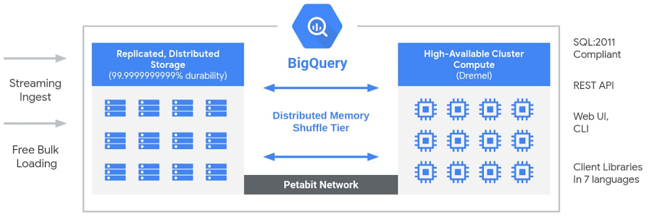
Why BigQuery is so fast ?
Columnar storage
Tree structure

Slide 11
Ingestion services
GCS Transfer Service
BigQuery Transfer service
Composer
Dataproc
Dataflow
Pub-sub
AI Platform

Slide 12
Cloud SQL to BigQuery Use Case

Slide 13
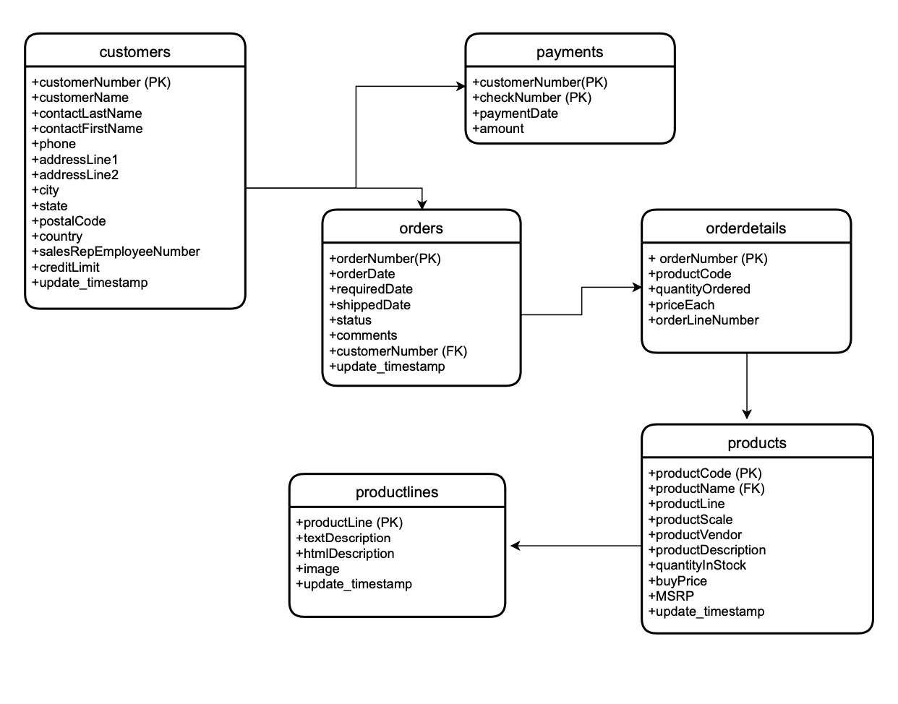
RDBMS

Slide 14
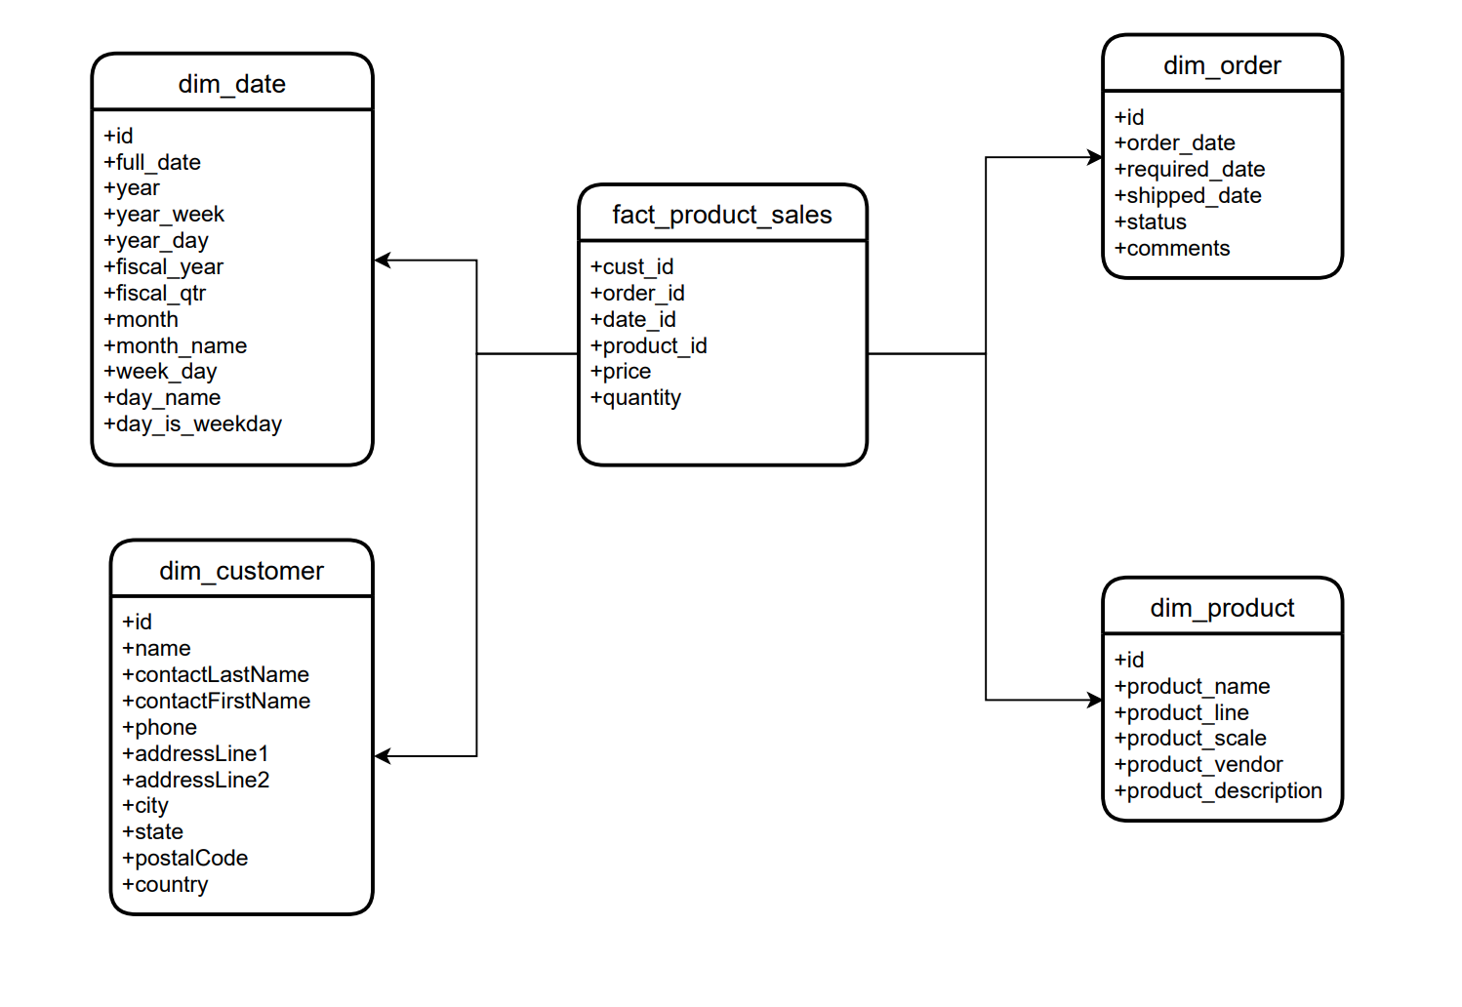
Warehouse

Slide 15
Machine Learning

Slide 16
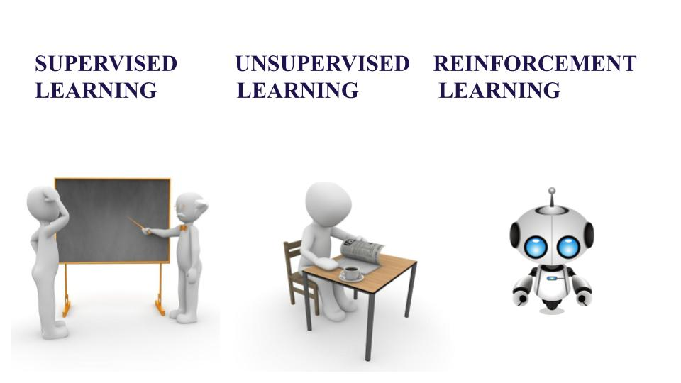

Slide 17
BigQuery ML

Slide 18
Supported models
Linear regression.
Logistic regression.
K-means clustering.
Time series.
More supported models can be found here.

Slide 19
BigQuery Classification Model Demo

Slide 20
GCS to BigQuery Use Case

